Slide 1


Optimal PV technology for our
climatic condition
D.HARI KRISHNA (20007)
K.LELLA SAI NAGESH (20018)
MENTOR – Dr.A.V Ramachandran Sir
(ECE) DEPARTMENT

Slide 2
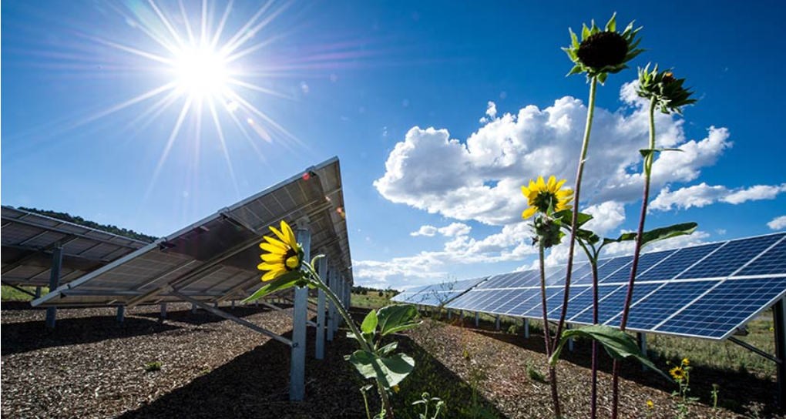
MOTIVATION
https://www.google.com/search?q=solar+panels&sxsrf=AJOqlzVCexVMyoCZ-gWwhDMfnv3SUnQlWg:1675411450132&source=lnms&tbm=isch&sa=X&ved=2ahUKEwjJxdmC8vj8AhWixjgGHQ1YAekQ_AUoAnoECAEQBA&biw=1536&bih=722&dpr=1.25
Environmental benefits
Financial savings
Government incentives
Corporate Companies

Slide 3
Objective:
By using modified SHOCKELY equation written a matlab code and implement the average temperature of chennai to get result graph of current and voltage.
In the energy3d software with the average temperature of chennai city and spain country to get results dialy energy analysis and daily net energy.

Slide 4
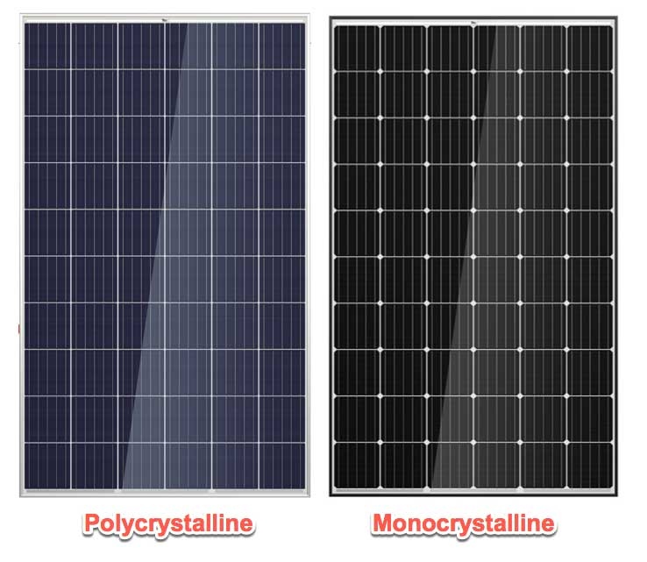
INTRODUCTION
Photovoltaic technology is now in full development in the world convert sunlight into electrical energy
photovoltaic technologies of silicon module:
polycrystalline silicon (pc-Si)
mono crystalline silicon (c-Si)
The optimal photo voltaic technology for a specific climate will depend upon
Temperature
Humidity
https://www.google.com/search?q=Mono+vs+poly&oq=Mono+vs+poly&aqs=chrome..69i57j0i67j0i131i433i512j0i512l3j69i60l2.11168j0j7&sourceid=chrome&ie=UTF-8

Slide 5
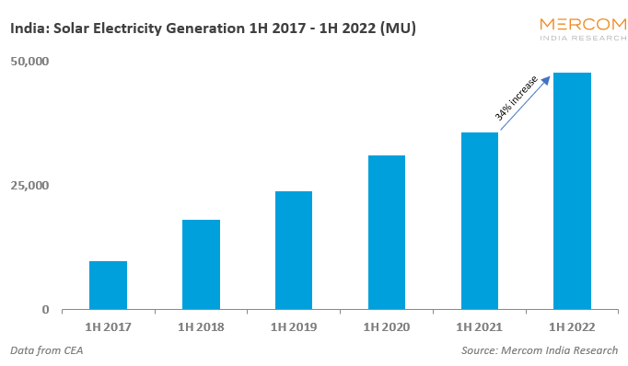
STATICS OF SOLAR ENERGY IN INDIA
https://www.google.com/search?q=mercom+statics+of+solar+in+india&oq=mercom+statics+of+solar+in+india&aqs=chrome..69i57j33i160l5.20023j0j7&sourceid=chrome&ie=UTF-8

Slide 6
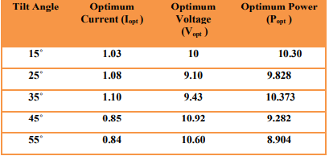
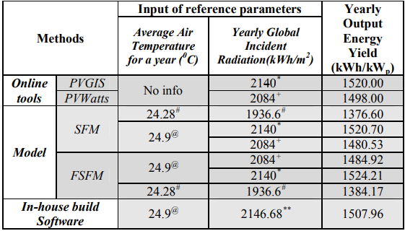
LITERATURE SURVEY
s.no | Paper | Author | Work proposed
1. | Determination of optimal Angle for maximum power of a PV Module under Bangladesh Climatic Condition | Shuva Paul Dr.Md. Kamrul Alam Khan
2. | A Study on the PV potential analysis for grid connected PV system in NIT Rourkela | Rakesh Kumar Tarai Mihir Kumar

Slide 7
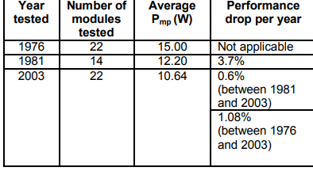
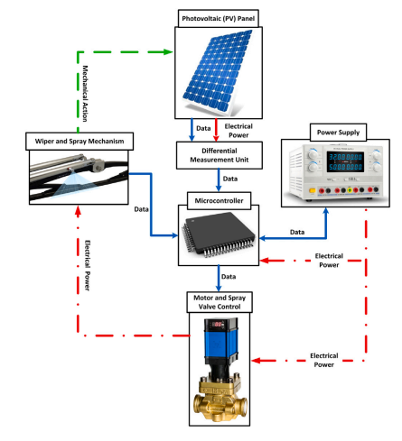
LITERATURE SURVEY
s.no | Paper | Author | Work proposed
3. | Photovoltaic modules operated in a hot-desert climatic condition | Yingtang tang Bindhu raghuraman
4. | Dust accumulation and aggregation on PV panels | Haris M. Khalid Zimran Rafique

Slide 8
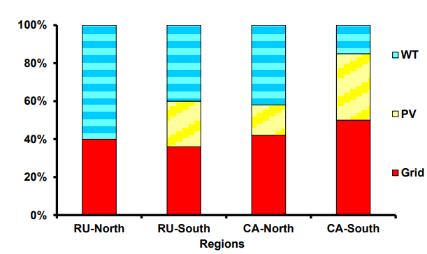
LITERATURE SURVEY
s.no | Paper | Author | Work proposed
5. | Competitiveness of Wind and Solar Energy Use in Asian Part of Russia and in Central Asia | O.V. Marchenko, S.V. Solomin
6. | Effect of Irradiance during foggy days and clear climatic conditions in Maximum Power Point in PV characteristics for Photovoltaic systems | Ankit Chowdhury Tanmay Rout
Results of the pv module give the power vs voltage and voltage vs current characteristics

Slide 9
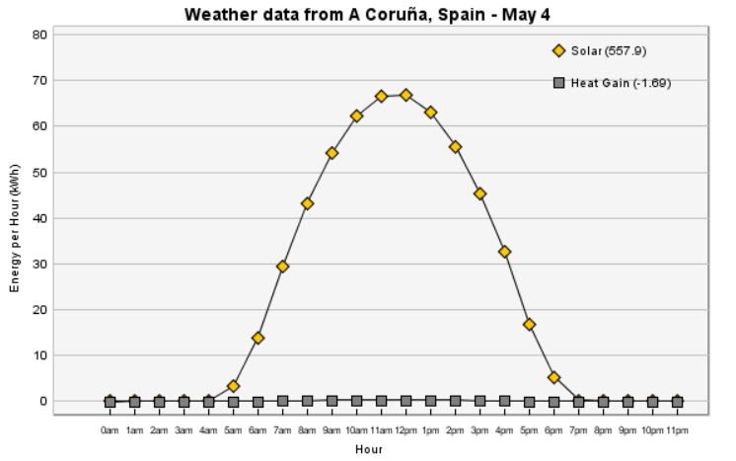
LITERATURE SURVEY
s.no | Paper | Author | Work proposed
7. | Using Spain Climatic Condition observing daily Energy analysis | Rajender Kumarl , Sanjay Kumar Sinha
8. | An evaluation of 27+ years old photovoltaic modules operated in a hot-desert climatic condition | Yingtang Tang1 , Bindhu Raghuraman1 , Joseph Kuitche1 , Govindasamy TamizhMani1 ,
In this study, photovoltaic modules operated over 27+ years in a hot-dry climatic condition have been evaluated.

Slide 10


SOFWATE USED:
ENERGY 3D SOFTWARE

Slide 11
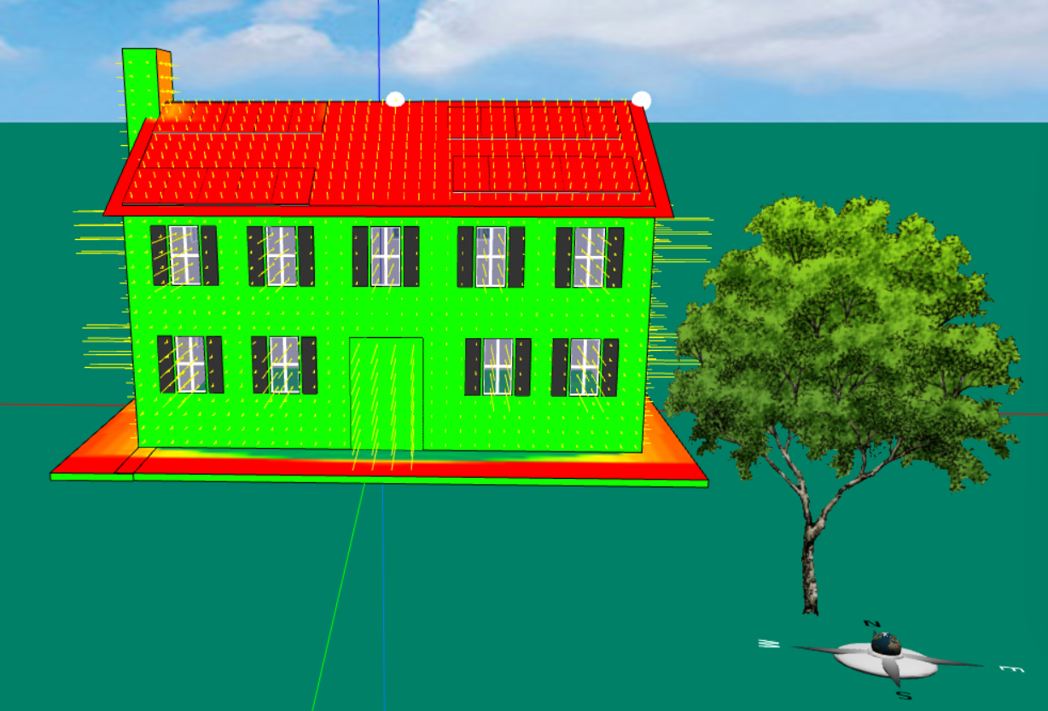


ENERGY3D

Slide 12
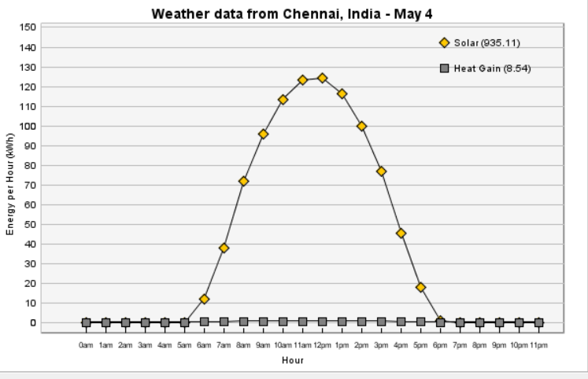
Comparision Table

Slide 13
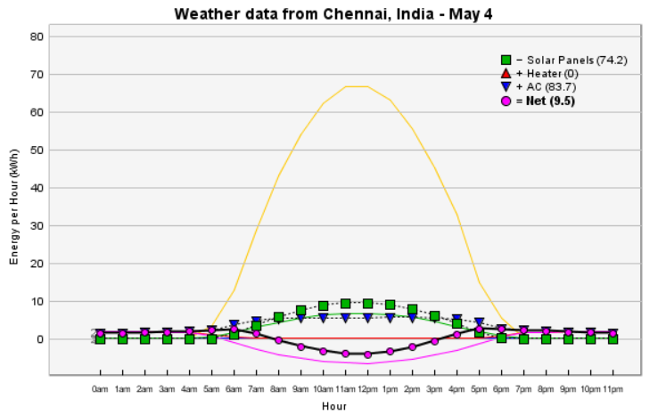
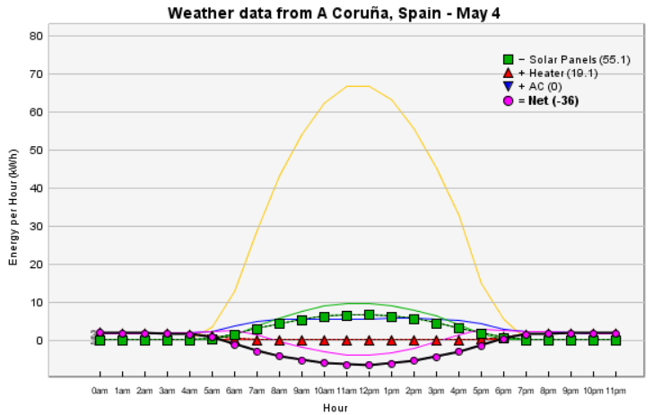
Comparision Table:

Slide 14
PV MODULE CODE
%% PV Module Simulation
% Define the parameters
Isc = 5.2; % Short-circuit current (A)
Voc = 21.3; % Open-circuit voltage (V)
Imp = 4.7; % Maximum power point current (A)
Vmp = 17.6; % Maximum power point voltage (V)
Ns = 36; % Number of cells in series
Np = 2; % Number of cells in parallel
Tc = 25; % Cell temperature (deg C)
G = 1000; % Irradiance (W/m^2)

Slide 15
% Calculate the parameters
K = 1.38064852e-23; % Boltzmann constant
q = 1.60217662e-19; % Electron charge
Vt = Ns * K * (Tc + 273.15) / q; % Thermal voltage
Iph = Isc / (Ns * Np); % Photocurrent
IL = Iph + (G / 1000) * (0.085 - 0.00015 * (Tc - 25)); % Light-generated current
Rsh = 100; % Shunt resistance (ohm)
Rs = 0.1; % Series resistance (ohm)
I0 = Isc / (exp(Voc / Vt) - 1); % Diode saturation current
V = 0:0.1:Voc; % Voltage range

Slide 16
% Calculate the I-V characteristics
I = IL - I0 * (exp((V + Rs * IL) / Vt) - 1) - (V + Rs * IL) / Rsh;
P = V .* I;
% Plot the I-V and P-V curves
figure;
plot(V, I);
xlabel('Voltage (V)');
ylabel('Current (A)');
title('I-V Characteristics');

Slide 17
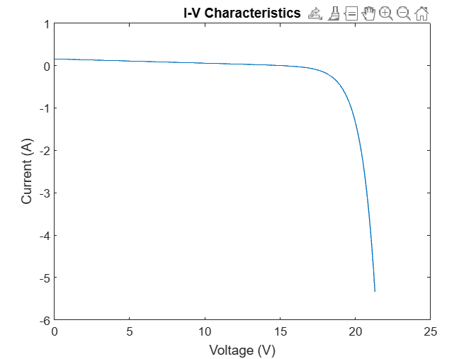
RESULTS

Slide 18
REFERENCES
R. K. Tarai, M. K. Sahoo, V. Minz and P. Kale, "A study on the PV potential analysis for grid connected PV system in NIT Rourkela," 2016 IEEE 7th Power India International Conference (PIICON), Bikaner, India, 2016, pp. 1-6, doi: 10.1109/POWERI.2016.8077149.
S. M. Hussain and M. S. Hoque, "Climate Exodus: The Migration Catastrophe of Bangladesh," 2020 IEEE Region 10 Symposium (TENSYMP), Dhaka, Bangladesh, 2020, pp. 1185-1188, doi: 10.1109/TENSYMP50017.2020.9231036.
Y. Tang, B. Raghuraman, J. Kuitche, G. TamizhMani, C. E. Backus and C. Osterwald, "An Evaluation of 27+ Years Old Photovoltaic Modules Operated in a Hot-Desert Climatic Condition," 2006 IEEE 4th World Conference on Photovoltaic Energy Conference, Waikoloa, HI, USA, 2006, pp. 2145-2147, doi: 10.1109/WCPEC.2006.279929.
https://www.researchgate.net/publication/367348243_Dust_Accumulation_and_Aggregation_on_PV_Panels_An_Integrated_Survey_on_Impacts_Mathematical_Models_Cleaning_Mechanisms_and_Possible_Sustainable_Solution
A. An, L. Chen, H. Zhang, B. Lv and X. Zhou, "The parameters-test of photovoltaic effect and the performance analysis of PV power system," Proceedings of the 33rd Chinese Control Conference, Nanjing, China, 2014, pp. 7022-7026, doi: 10.1109/ChiCC.2014.6896159.

Slide 19
THANK YOU

